Slide 1

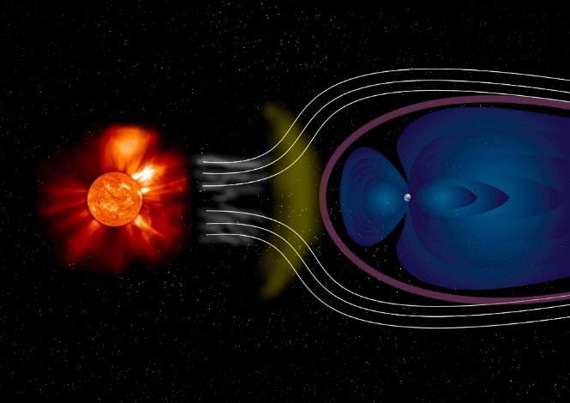
Electromagnetics
# 3
G. M. Parsanasab
References:
[1] David J. Griffiths, Introduction to Electrodynamics-Cambridge University Press (2017).
[2] Cheng, David Keun, Field and wave electromagnetics-Pearson New international ed. (2013_2014).
[3] Purcell E.M., Morin D.J. - Electricity and Magnetism-Cambridge University Press (2013).
[4] Jr. George Brinton Thomas, Christopher Heil, Joel Hass, Przemyslaw Bogacki, Maurice D. Weir, University calculus, early transcendentals (2020).

Slide 2
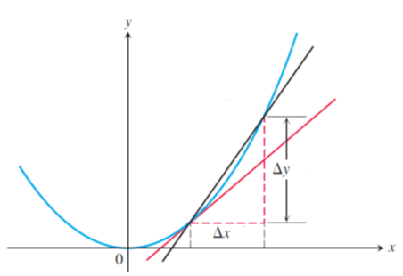
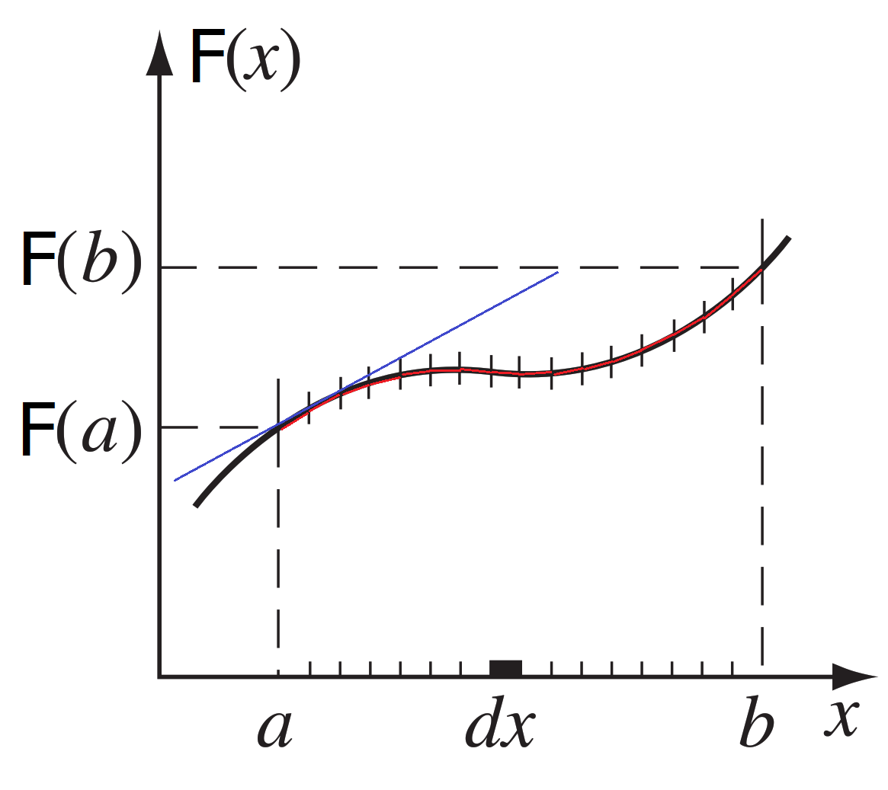

INTEGRAL CALCULUS
The notation employed here is different from the one used in [1] David J. Griffiths.

Slide 3
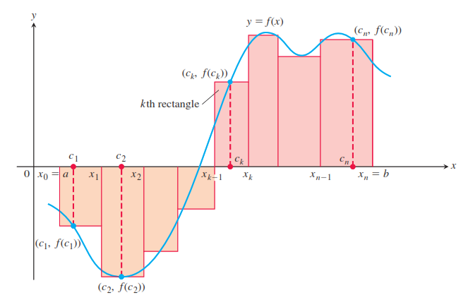
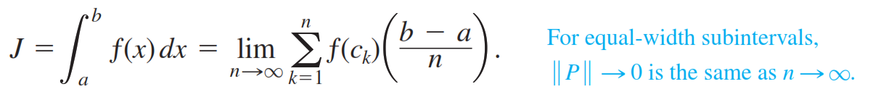
INTEGRAL CALCULUS

Slide 4
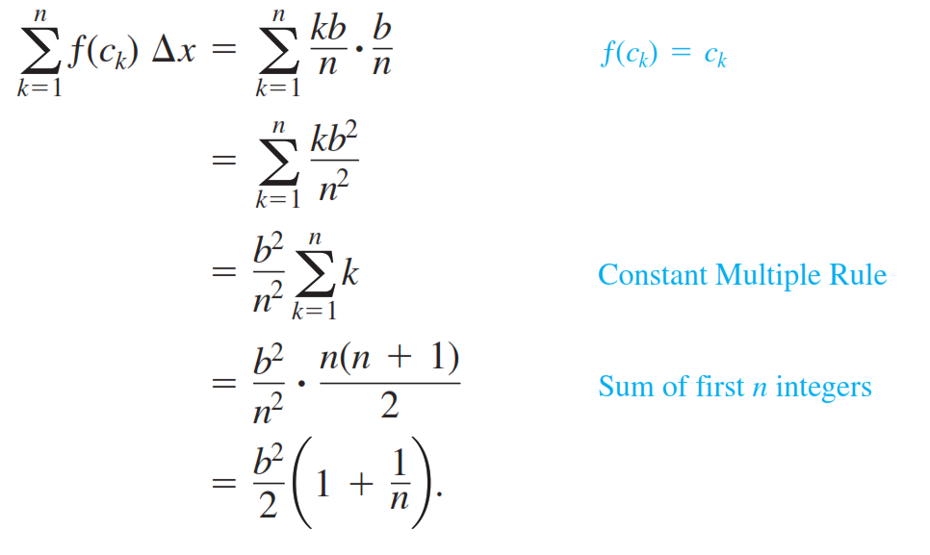
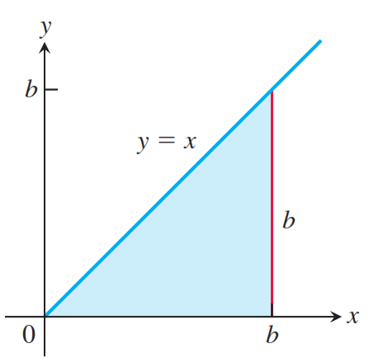
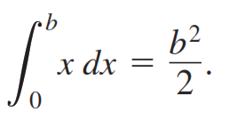

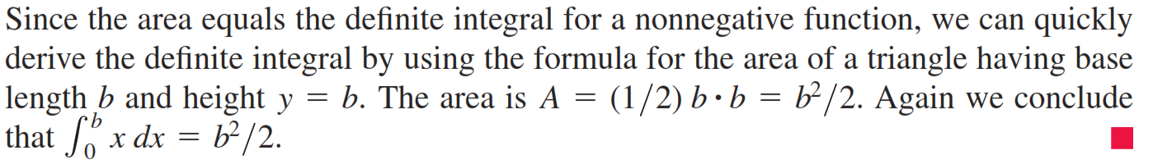
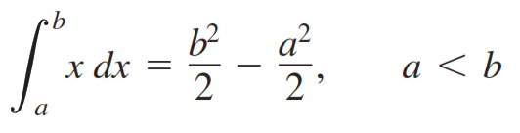
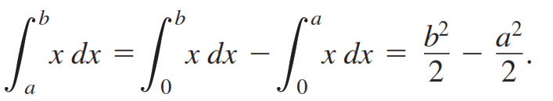

Slide 5
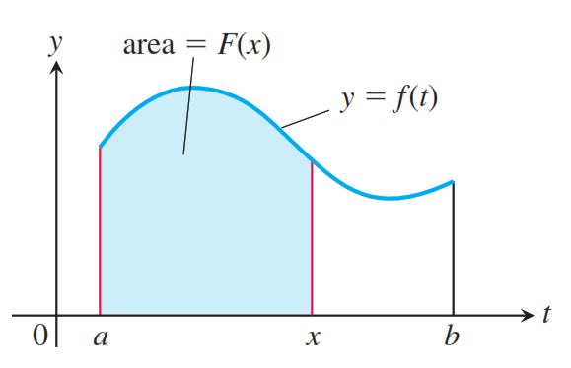
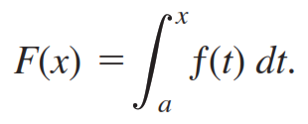
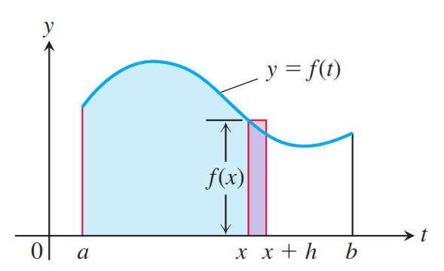
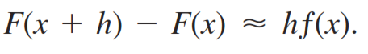
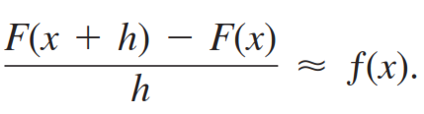
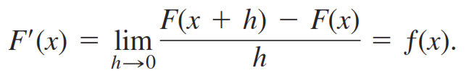
Fundamental theorem of integral calculus

Slide 6
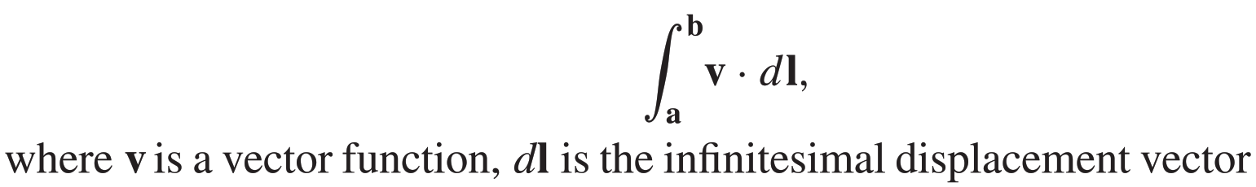
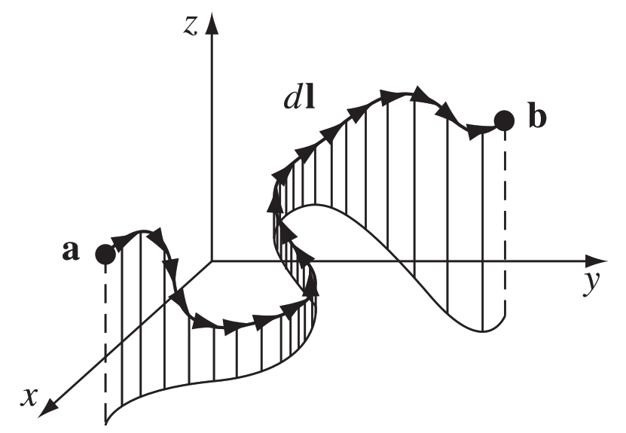
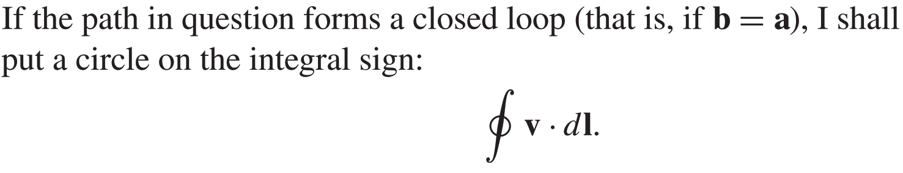
In electrodynamics, we encounter several different kinds of integrals:
line (or path) integrals,
surface integrals(or flux),
volume integrals.
(a) line (or path) integrals,
closed loop path:
Ordinarily, the value of a line integral depends critically on the path taken from a to b,
but there is an important special class of vector functions for which the line integral is independent of path and is determined entirely by the end points. (A force that has this property is called conservative.)

Slide 7
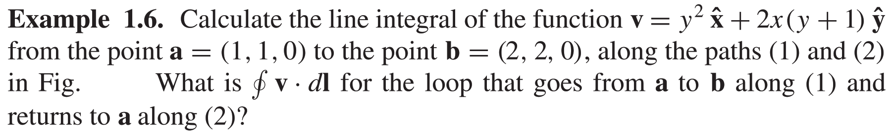
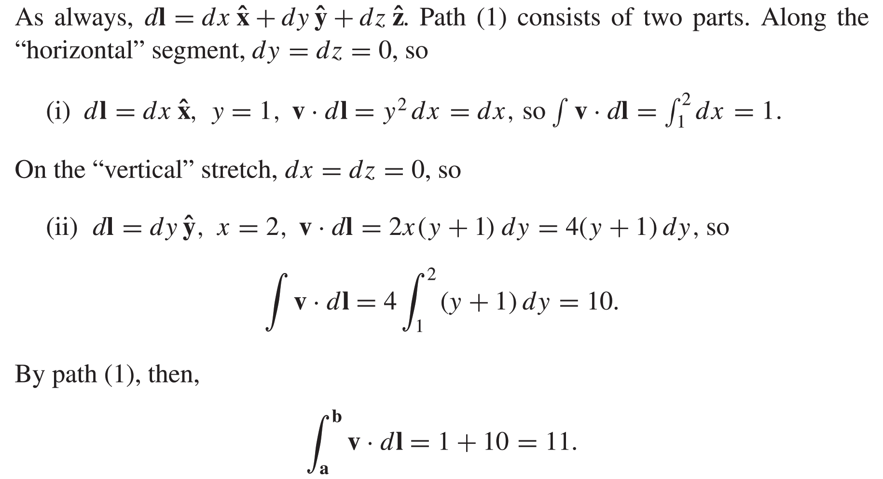
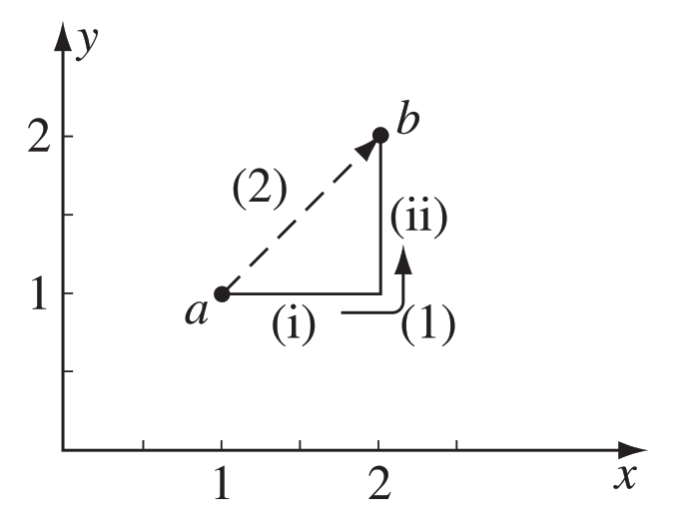

Slide 8
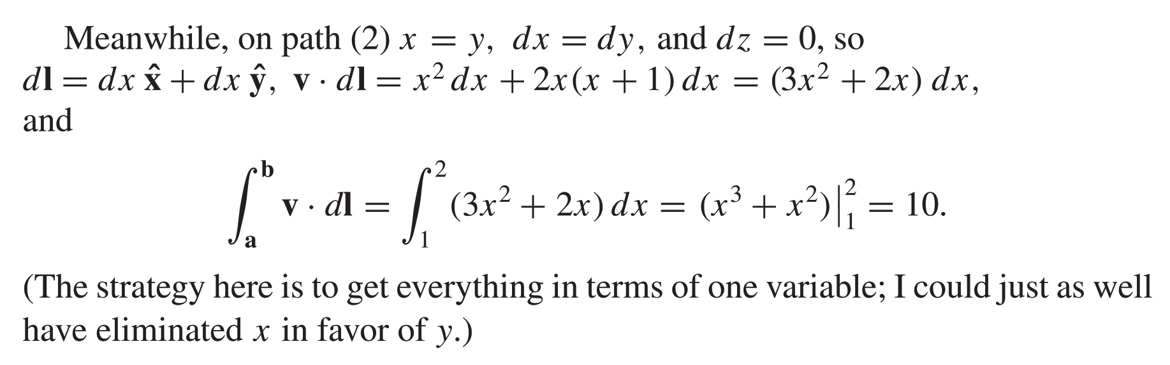
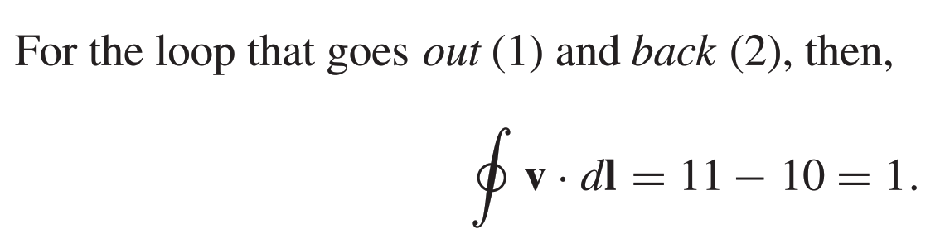

Slide 9
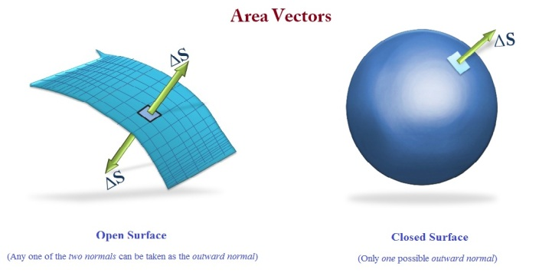
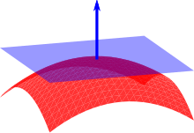
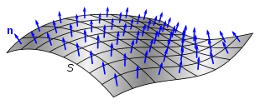
(b) Surface Integrals

Slide 10
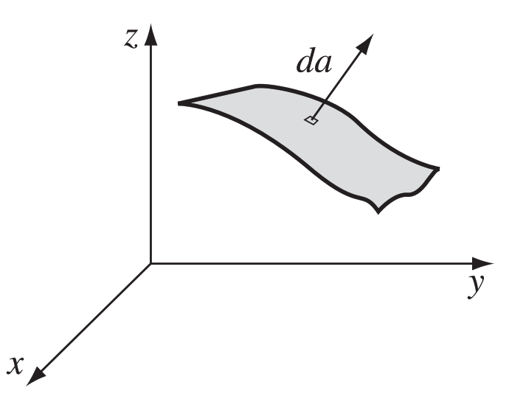
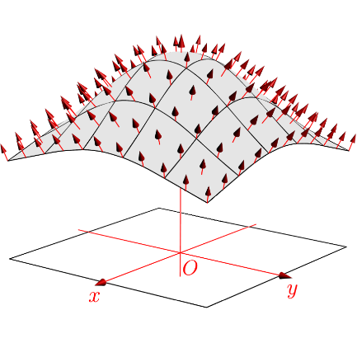
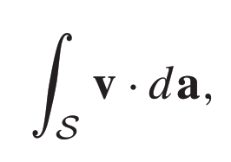
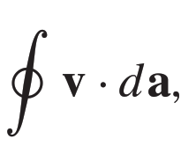
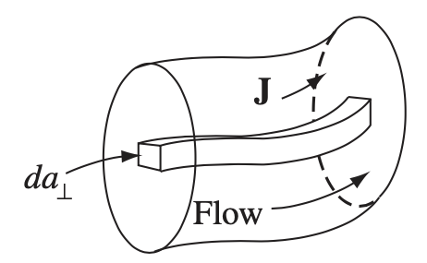
(b) Surface Integrals
If the surface is closed
Integral sign
If the surface is closed, “outward” is positive,
For open surfaces it’s arbitrary
If v describes the flow of a fluid (mass per unit area per unit time),
represents the total mass per unit time passing through the surface, “flux.”
Current density: J

Slide 11
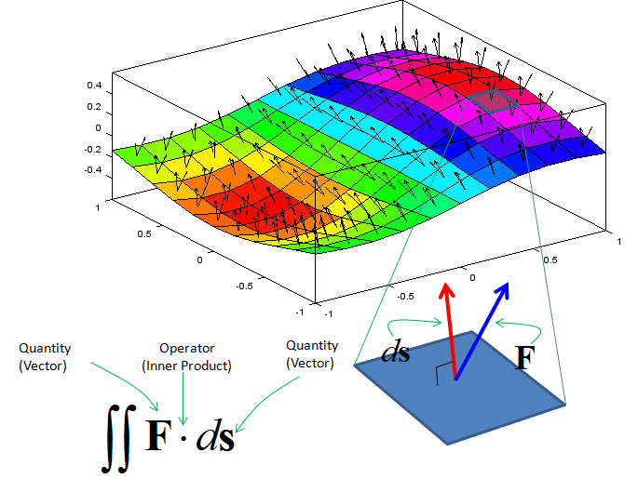

Slide 12
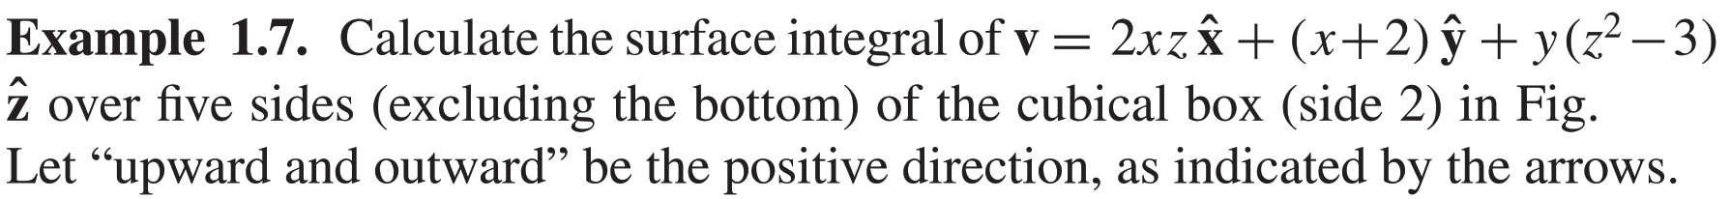
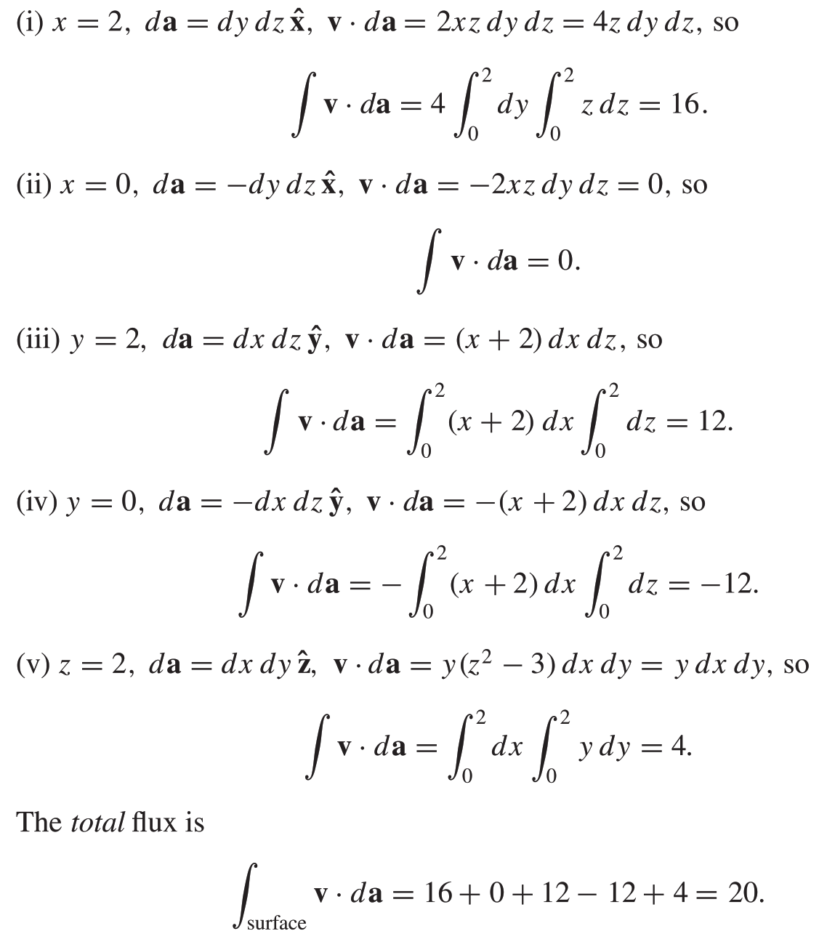
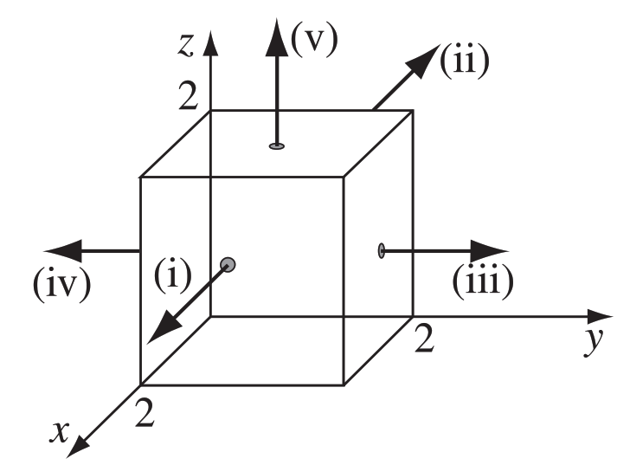

Slide 13
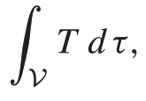
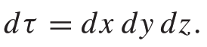
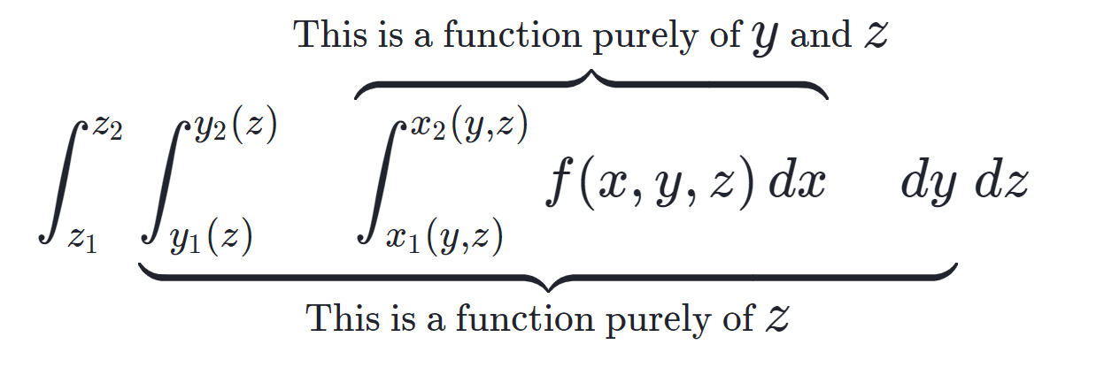
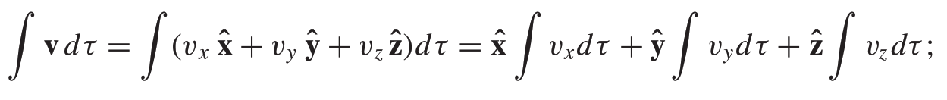
(c) Volume Integrals
volume element
If ρ is the density of a substance
volume integral equals the total mass.
Volume integrals of vector functions:
The unit vectors are constants, they come outside the integral.

Slide 14
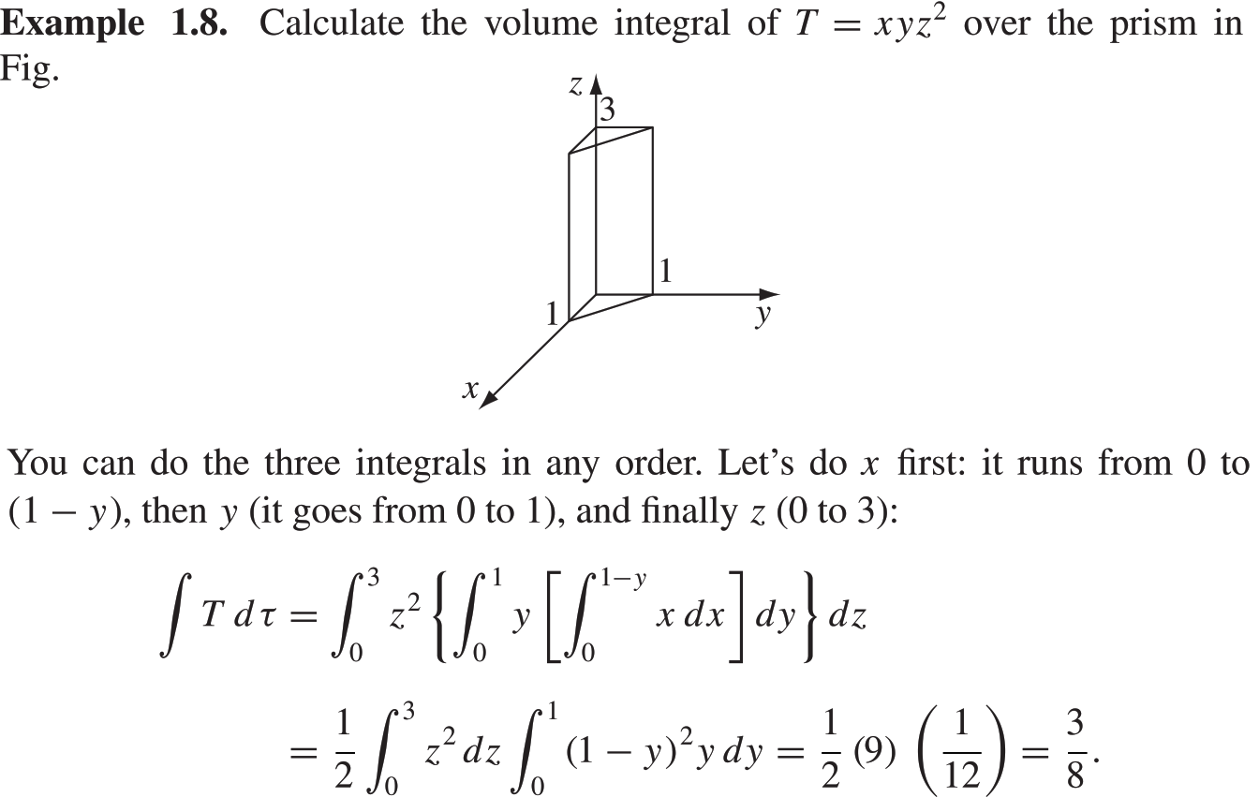

Slide 15
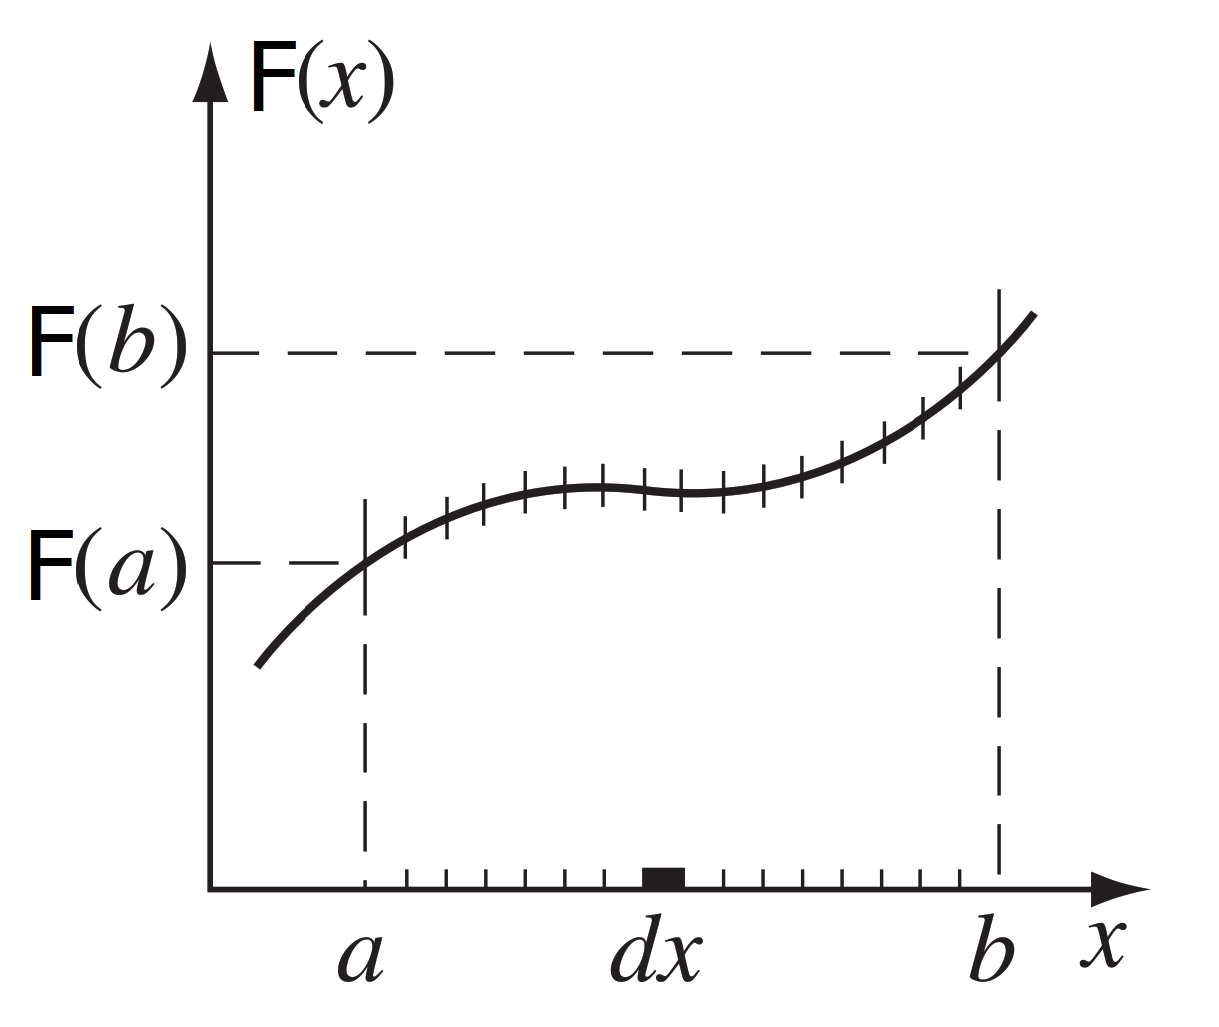
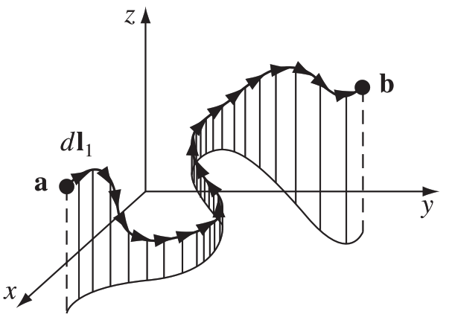
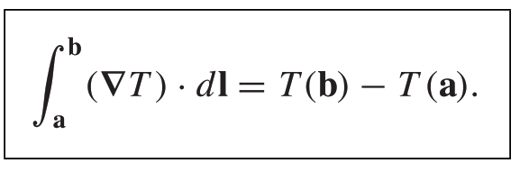
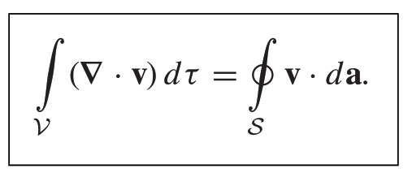
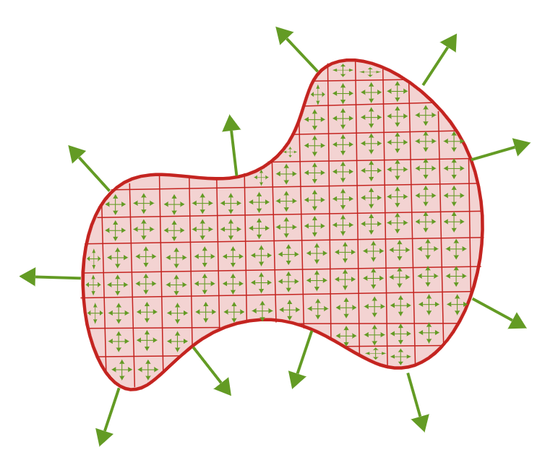
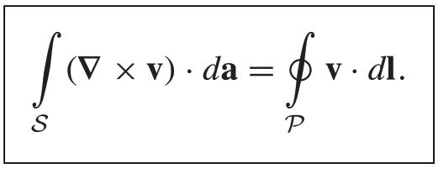
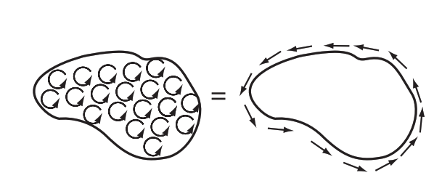
The Fundamental Theorem of
Calculus, Gradients, Divergences and Curls
The Fundamental Theorem of Calculus
The Fundamental Theorem for Gradients
The Fundamental Theorem for Divergences
The Fundamental Theorem for Curls

Slide 16
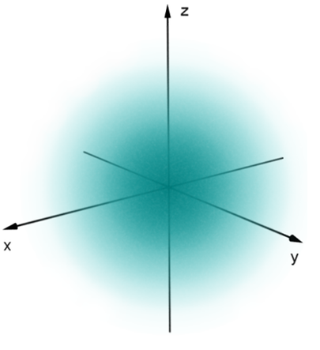


The Fundamental Theorem for Gradients
b
a

Slide 17


The integral is independent of path,
Let’s go out along the x axis (step i) and then up (step ii).

Slide 18



Calculate the same along path iii (the straight line from a to b):

Slide 19



The Fundamental Theorem for Divergences
Gauss’s theorem or Green’s theorem

Slide 20


Slide 21



Slide 22



Slide 23




The Fundamental Theorem for Curls

Slide 24



https://www.khanacademy.org/math/multivariable-calculus/greens-theorem-and-stokes-theorem/greens-theorem-articles/a/greens-theorem

Slide 25

Y
Z
X
Y
Z
X

Slide 26


Slide 27




z
y
x
Counterclockwise line integral
Clockwise line integral

Slide 28

notice step (iii): the path goes to the left. | running the integral from 0 → 1
 | But it is safer to write never any minus signs and let the limits of the integral take care of the direction. running the integral from 1 → 0

Slide 29




Integration by Parts

Slide 30





The integrand is the product of one function ( f ) and the derivative of another (A),
transfer the derivative from A to f (where it becomes a gradient), at the cost of a minus sign and a boundary term (in this case a surface integral)

